Slide 1
Automated robust first peak detection in a time signal using computational Intelligence
Information Technology (M.Engg)
Submitted by:
Deblina Karmakar (Matriculation 1427365)
Indranil Saha (Matriculation 1427190)
Kumar Satyam (Matriculation 1441354)
Examined by:
Prof. Dr. Andreas Pech

Slide 2
Contents
Introduction
Flowchart & Experiment Overview
Utilised classes
Output
Conclusion
References

Slide 3
Introduction
Why Computational Intelligence?
What is Peak Detection?
Benefit of Peak Detection ?
Computational intelligence uses different methods like machine learning, artificial neural networks to create algorithms for detecting peaks for noisy complicated signals.
The process of identifying and locating the highest points (peaks) or local maxima in a signal.
Determine the initiation of an event
Locate the value within a signal
Identify abnormal occurrences within a signal

Slide 4
Flowchart
Start
Creation of FFT, removing noise and IFFT
Hilbert Transform for envelop of signal
Calculation of peaks
Group peaks in same window, Label the data as peak/no peak
Creation of 1D CNN model
CNN training and saving trained model
Peak detection from trained model
End

Slide 5

Experiment Overview
Signal transformation using FFT from time to frequency domain
Modification of FFT co-efficient eliminating imaginary values
Filtering of noisy data above the predicted noise floor
Enforcing IFFT for de-noise of signal
Calculation of power spectrum
Removing small Fourier co-efficient
Utilization of Hilbert Transform for envelop extraction
Generation of CNN model for peak detection using supervised learning
Fine tuning of CNN using training and testing dataset
Peak detection using the trained CNN model

Slide 6
Utilised classes
The class encapsulates the entire pipeline for processing a specific dataset.
Reduce noise in signal data
Label data based on peak detection
Train CNN model for classification of tasks
Checks for GPU availability to leverage GPU resources for faster training
Several python libraries (numpy, pandas, matplotlib.pyplot, SciPy.Signal etc) are used to achieve the desired results.
CNN_Model.py

Slide 7
Utilised classes
Reshape input data for prediction.
Use loaded model to make prediction on the input data
Calculate and adjust peak values based on model prediction
Reduce noise and group labelled data
Spilt dataset into training and testing data
Make prediction on a specific data point
Display peak value
model_predict.py

Slide 8
Utilised classes
Use specific dataset for training and testing CNN model
Perform data cleaning and prepare data to train CNN
Organize labelled data into batches and categories
Training dataset is used to train CNN model
Testing dataset is used to evaluate model’s performance
Provide information about available GPUs, crucial for optimizing training process for large dataset
model_train.py

Slide 9
Utilised classes
This script is a foundation of web application allowing users to upload data files
Perform data analysis on a subset of data
Make predictions of the uploaded dataset
Visualize the result using Matplotlib plots.
Showcase result to a PNG image form
Servers as interactive tool for data analysis and peak detection in the uploaded files.
App.py

Slide 10
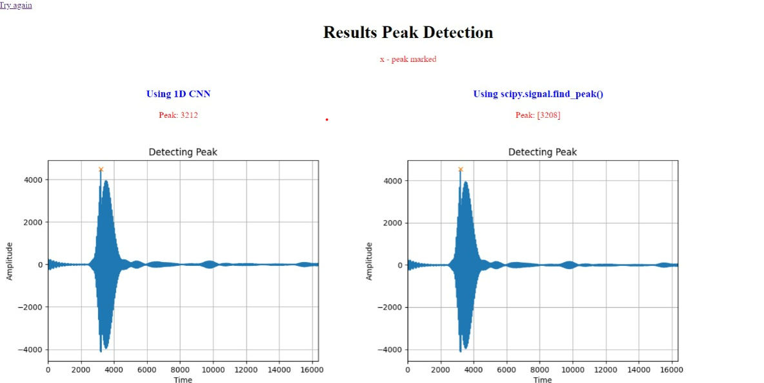
Output

Slide 11

Conclusion
CNN model is effective and efficient to detect peak in a signal, even in a noisy environment.
Neural network based peak detector exploits peak shape information successfully with a superior performance.
After grouping, it needs approximation to match actual results that doesn't give high actual peak, but a window in which peak is present.
To improve accuracy, need to make small window which matches kernel size of CNN.

Slide 12

References
[1] H. Pan, Y. Chen, X. Niu, W. Zhou and D. Li, “Learning Convolutional Neural Networks in the Frequency Domain,” Changsha, China, 2022.
[2] Hoshen Y., Weiss R. J. and Wilson K. W., “Speech acoustic modeling from raw mutichannel waveforms,” IEEE International Conference on Acoustic, Speech and Signal Processing (ICASSP), 2015.
[3] Bruce A., Donoho D. and Gao H. Y., “Wavelet analysis [for signal processing],” IEEE spectrum, 1996.
[4] Osgood B. G., “Lectures on the Fourier Transform and it's application,” American Mathematical Society, 2019.
[5] Bracewell R., The Fourier Transform and it`s application, McGraw-Hill, 1965.
[6] King F. W., Hilbert Transform, Vol. 2, Cambridge, UK: Cambridge University Press, 2009.

Slide 13


